Slide 1

Method of variation of parameters

Slide 2
Method of variation of parameters
When short-cut methods fail to determine the particular integral then one has to make use of general method . But this method involves laborious integration and in such cases we use the method of variation of parameters.

Slide 3
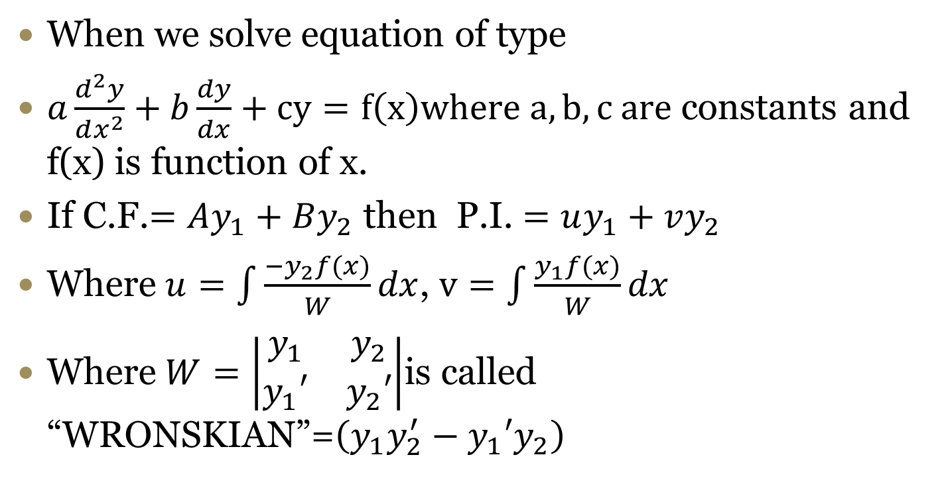
Method of variation of parameters
When we solve equation of type
$a\frac{d^{2}y}{dx^{2}}+b\frac{dy}{dx}+cy=f\left(x\right)where a,b, c are$constants and f(x) is function of x.
If C.F.$=Ay_{1}+By_{2}$ then P.I. $=uy_{1}+vy_{2}$
Where $u=\int{\frac{−y_{2}f(x)}{W}dx}$, $v=\int{\frac{y_{1}f(x)}{W}dx}$
Where $W=\left|\begin{matrix}y_{1} & y_{2} \\ y_{1}′ & y_{2}′\end{matrix}\right|$is called “WRONSKIAN”=$\left(y_{1}y_{2}^{′}−y_{1}′y_{2}\right)$

Slide 4

Solve by method of variation of parameters $\frac{d^{2}y}{dx^{2}}+y=cosec x.$
consider ($D^{2}+1)y=0$
A.E. $D^{2}e^{0x}(A\cos{x}+B\sin{x})=A\cos{x}+B\sin{x}=Ay_{1}+By_{2}$
$\text{Here} y_{1}+1$= 0 $∴D=±i$
C.F. $==\cos{x},$ $y_{2}=\sin{x}$
Let P.I.=u$y_{1}+vy_{2}$
$W=\left|\begin{matrix}y_{1} & y_{2} \\ y_{1}′ & y_{2}′\end{matrix}\right|=\left|\begin{matrix}\cos{x} & \sin{x} \\ −\sin{x} & \cos{x}\end{matrix}\right|=1$
$u=\int{\frac{−y_{2}f(x)}{W}dx}=\int{\frac{−\sin{x cosec x}}{1}dx=\int{−dx=−x}}$
$v=\int{\frac{y_{1}f(x)}{W}dx}=\int{\frac{\cos{x cosec x}}{1}dx=\int{cotxdx=\log{\sin{x}}}}$
P.I.=$\left(−x\right)cosx+\{\log{\sin{x}}$}sinx
G.S. $y=A\cos{x}+B\sin{x}−\left(x\right)cosx+\{\log{\sin{x}}$}sinx

Slide 5
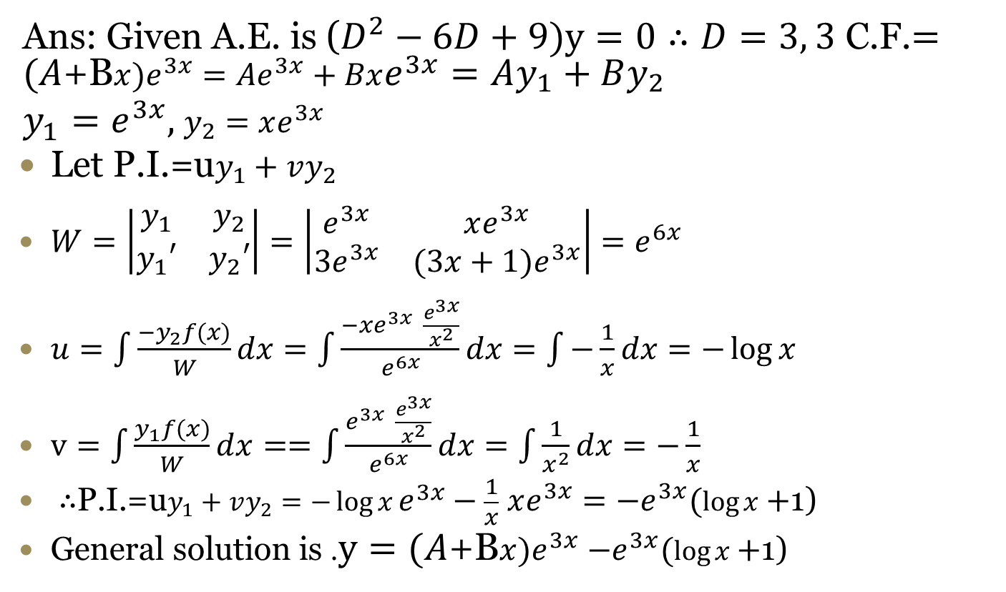
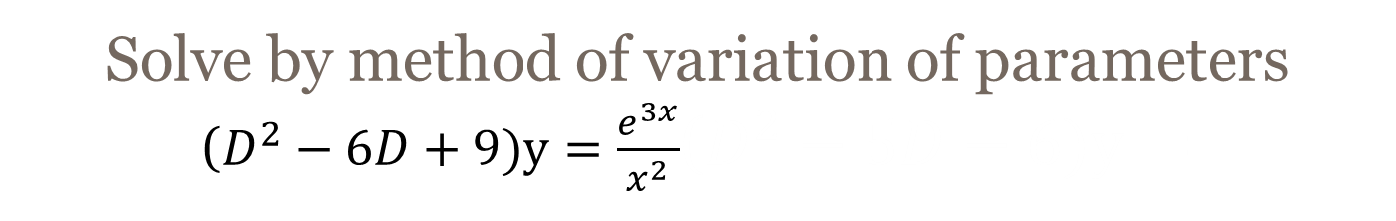
Solve by method of variation of parameters
($D^{2}−6D+9)y=\frac{e^{3x}}{x^{2}}$($D^{2}−5D−6)y=$
Ans: Given A.E. is ($D^{2}−6D+9)y=0∴D=3, 3$ C.F.$=(A$+B$x)e^{3x}=Ae^{3x}+Bxe^{3x}=Ay_{1}+By_{2}$
$y_{1}=e^{3x},$ $y_{2}=xe^{3x}$
Let P.I.=u$y_{1}+vy_{2}$
$W=\left|\begin{matrix}y_{1} & y_{2} \\ y_{1}′ & y_{2}′\end{matrix}\right|=\left|\begin{matrix}e^{3x} & xe^{3x} \\ 3e^{3x} & (3x+1)e^{3x}\end{matrix}\right|=e^{6x}$
$u=\int{\frac{−y_{2}f(x)}{W}dx}=\int{\frac{−xe^{3x} \frac{e^{3x}}{x^{2}}}{e^{6x}}dx=\int{−\frac{1}{x}dx=−\log{x}}}$
$v=\int{\frac{y_{1}f(x)}{W}dx}==\int{\frac{e^{3x} \frac{e^{3x}}{x^{2}}}{e^{6x}}dx=\int{\frac{1}{x^{2}}dx=−\frac{1}{x}}}$
$∴$P.I.=u$y_{1}+vy_{2}=−\log{x}e^{3x}−\frac{1}{x}$ $xe^{3x}=−e^{3x}(\log{x}+$1)
General solution is .$y=(A$+B$x)e^{3x}$ $−e^{3x}(\log{x}+$1)

Slide 6
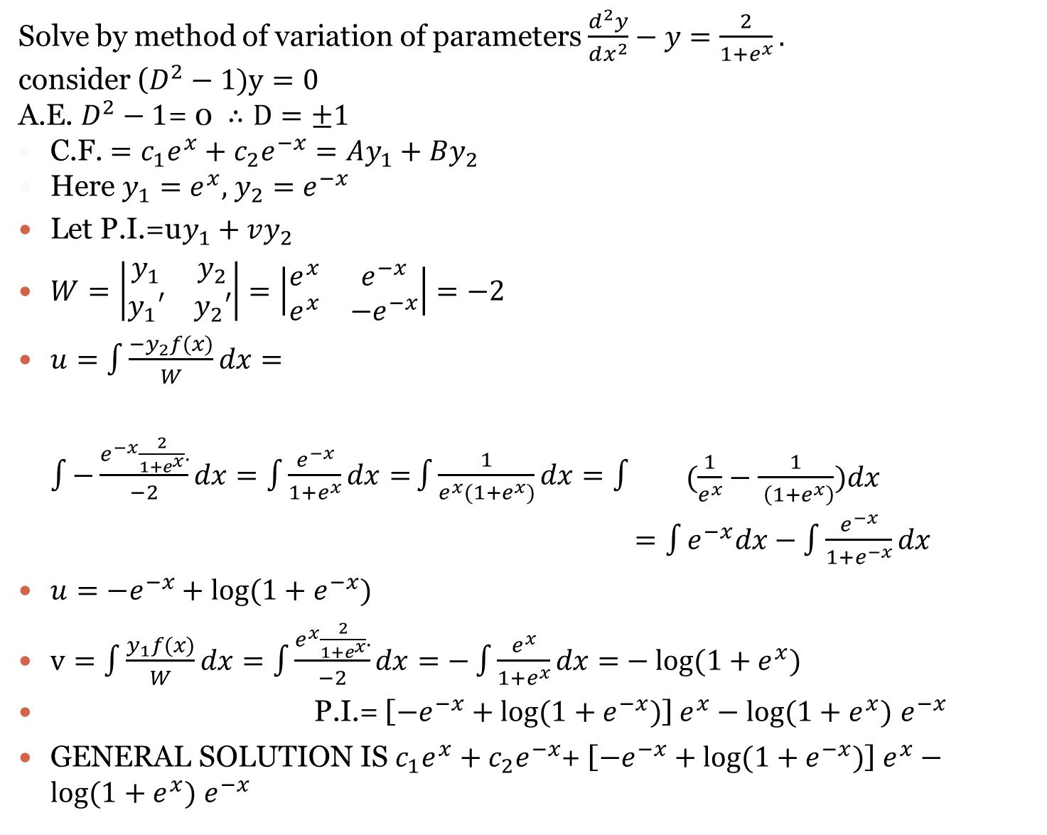
Solve by method of variation of parameters $\frac{d^{2}y}{dx^{2}}−y=\frac{2}{1+e^{x}}.$
consider ($D^{2}−1)y=0$
A.E. $D^{2}−1$= 0 $∴D=±1$
C.F. $=c_{1}e^{x}+c_{2}e^{−x}=Ay_{1}+By_{2}$
Here $y_{1}=e^{x},$ $y_{2}=e^{−x}$
Let P.I.=u$y_{1}+vy_{2}$
$W=\left|\begin{matrix}y_{1} & y_{2} \\ y_{1}′ & y_{2}′\end{matrix}\right|=\left|\begin{matrix}e^{x} & e^{−x} \\ e^{x} & −e^{−x}\end{matrix}\right|=−2$
$u=\int{\frac{−y_{2}f(x)}{W}dx}=\int{−\frac{e^{−x}\frac{2}{1+e^{x}}.}{−2}dx=\int{\frac{e^{−x}}{1+e^{x}}dx=}}\int{\frac{1}{e^{x}(1+e^{x})}dx=\int{\begin{aligned} \\ \\ (\frac{1}{e^{x}}−\frac{1}{ \left(1+e^{x}\right)})dx \\ =\int{e^{−x}dx}−\int{\frac{e^{−x}}{1+e^{−x}}dx}\end{aligned}}}$
$u=−e^{−x}+log⁡(1+e^{−x})$
$v=\int{\frac{y_{1}f(x)}{W}dx}=\int{\frac{e^{x}\frac{2}{1+e^{x}}.}{−2}dx=−\int{\frac{e^{x}}{1+e^{x}}dx=}}−log⁡(1+e^{x})$
$∴$P.I.=u$y_{1}+vy_{2pP.I.}$P.I.= [$−e^{−x}+log⁡(1+e^{−x})$] $e^{x}−log⁡(1+e^{x})$ $e^{−x}$
GENERAL SOLUTION IS $c_{1}e^{x}+c_{2}e^{−x}$+ [$−e^{−x}+log⁡(1+e^{−x})$] $e^{x}−log⁡(1+e^{x})$ $e^{−x}$

